Slide 1

A MODEST PROPOSAL TO DISRUPT THE WAY BUILDINGS ARE BUILT

Slide 2
“Better, Cheaper, Faster”
PanLbilt Global provides an exciting 21st Century Market Disruptive Patented Environmentally Green, Energy Efficient, & Smart Buildings Technology to revitalize construction of custom designed factory manufactured buildings, neighborhoods and business enterprise zones with an attractive ROI and enhanced shareholder value.

Slide 3
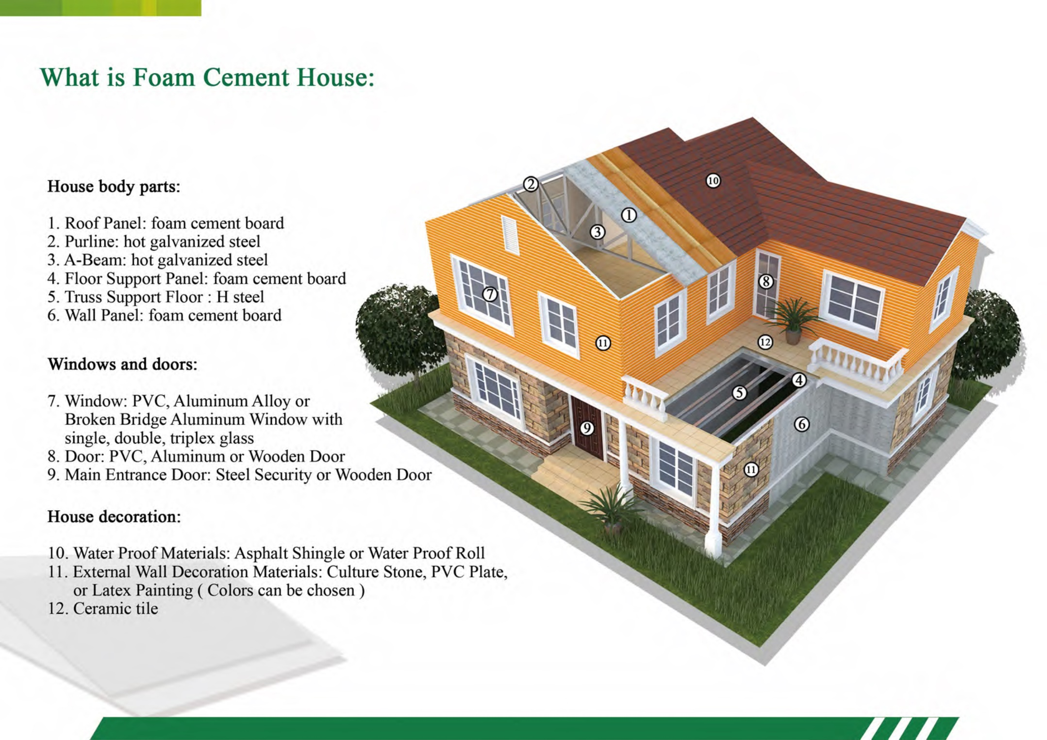

Slide 4
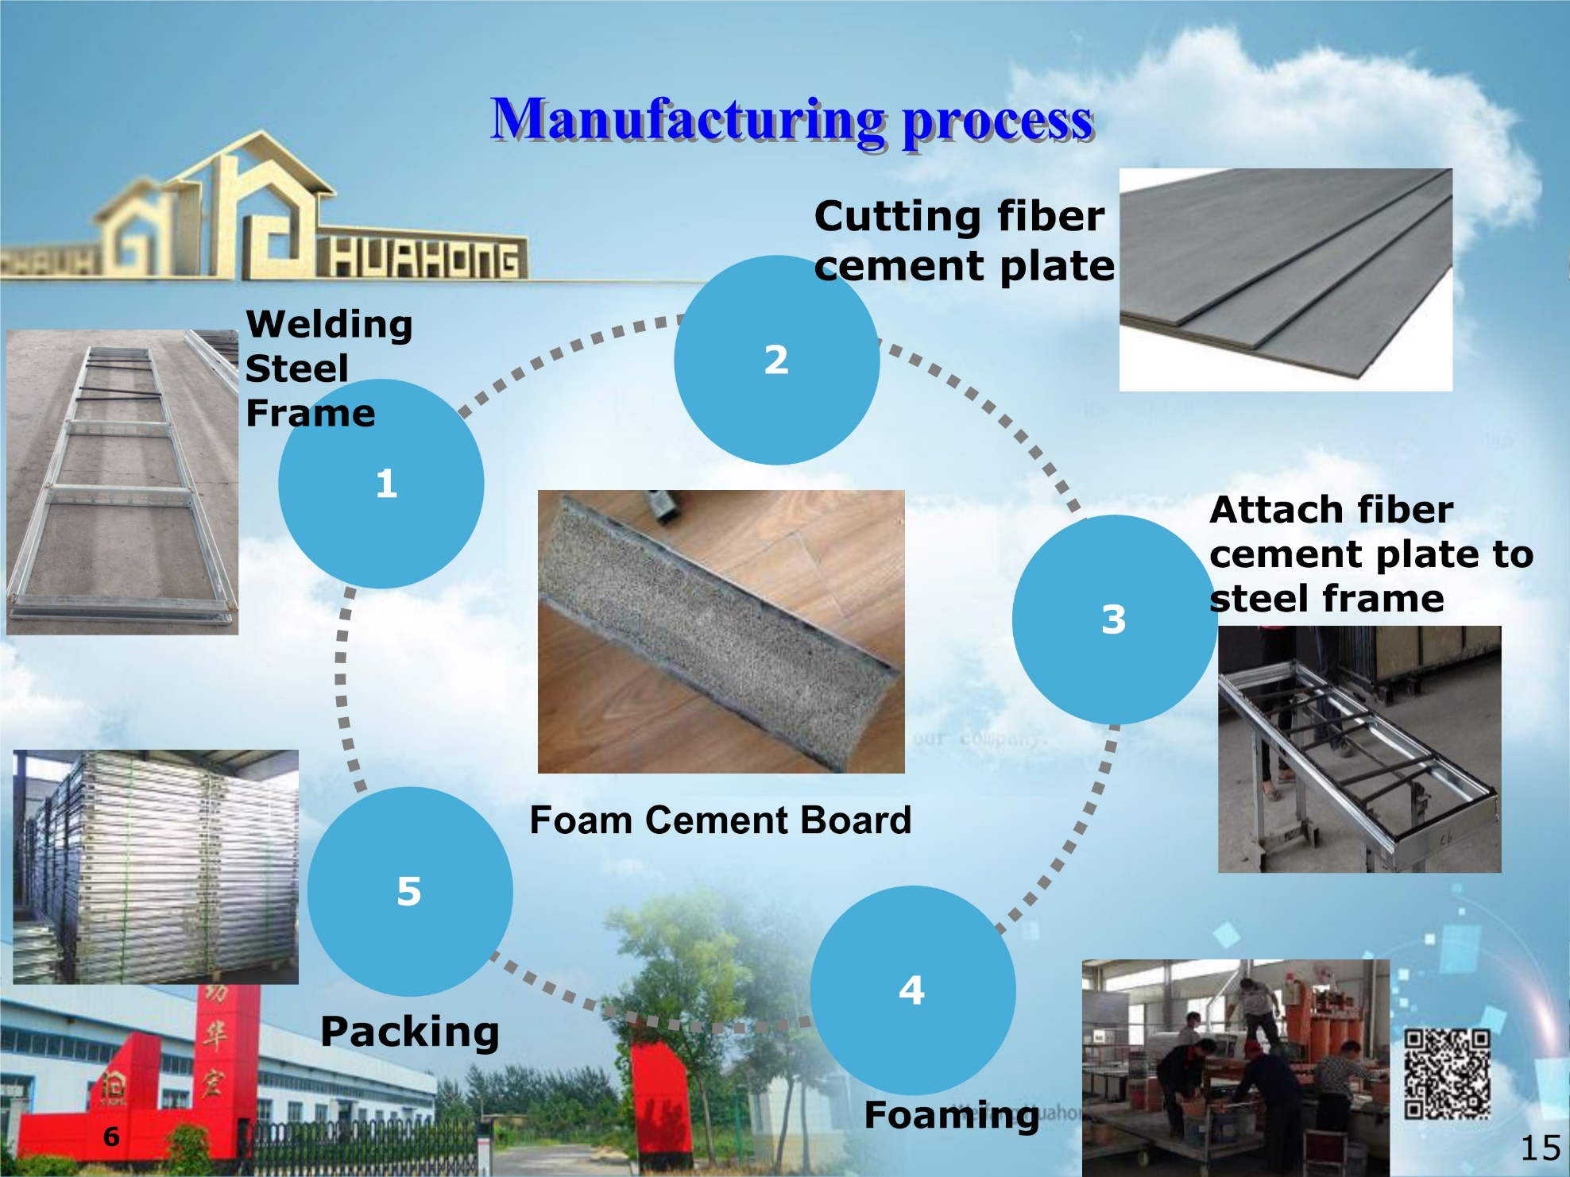

Slide 5
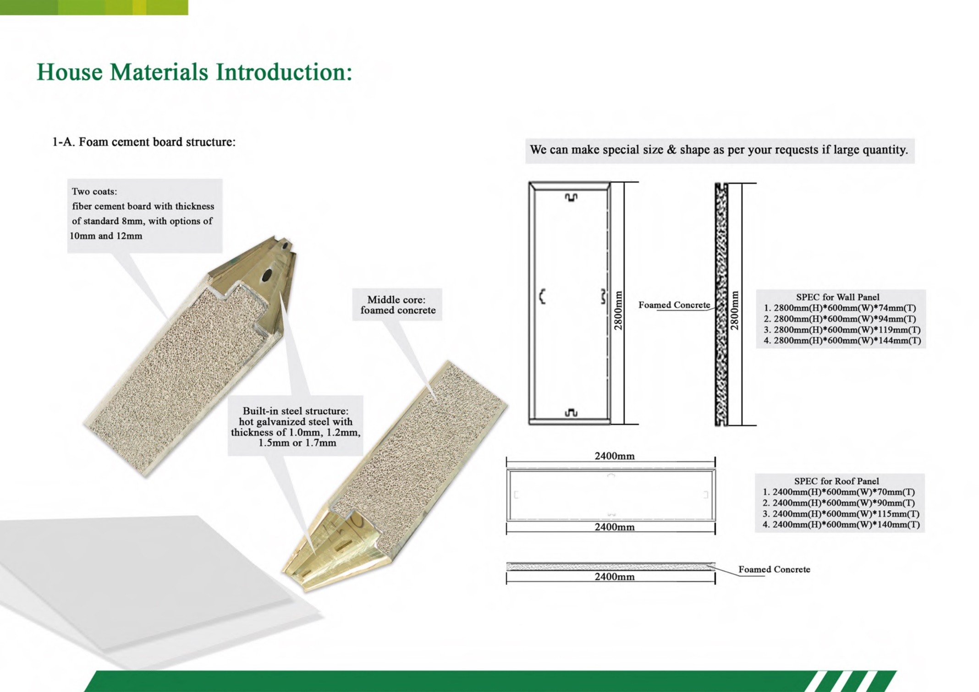

Slide 6
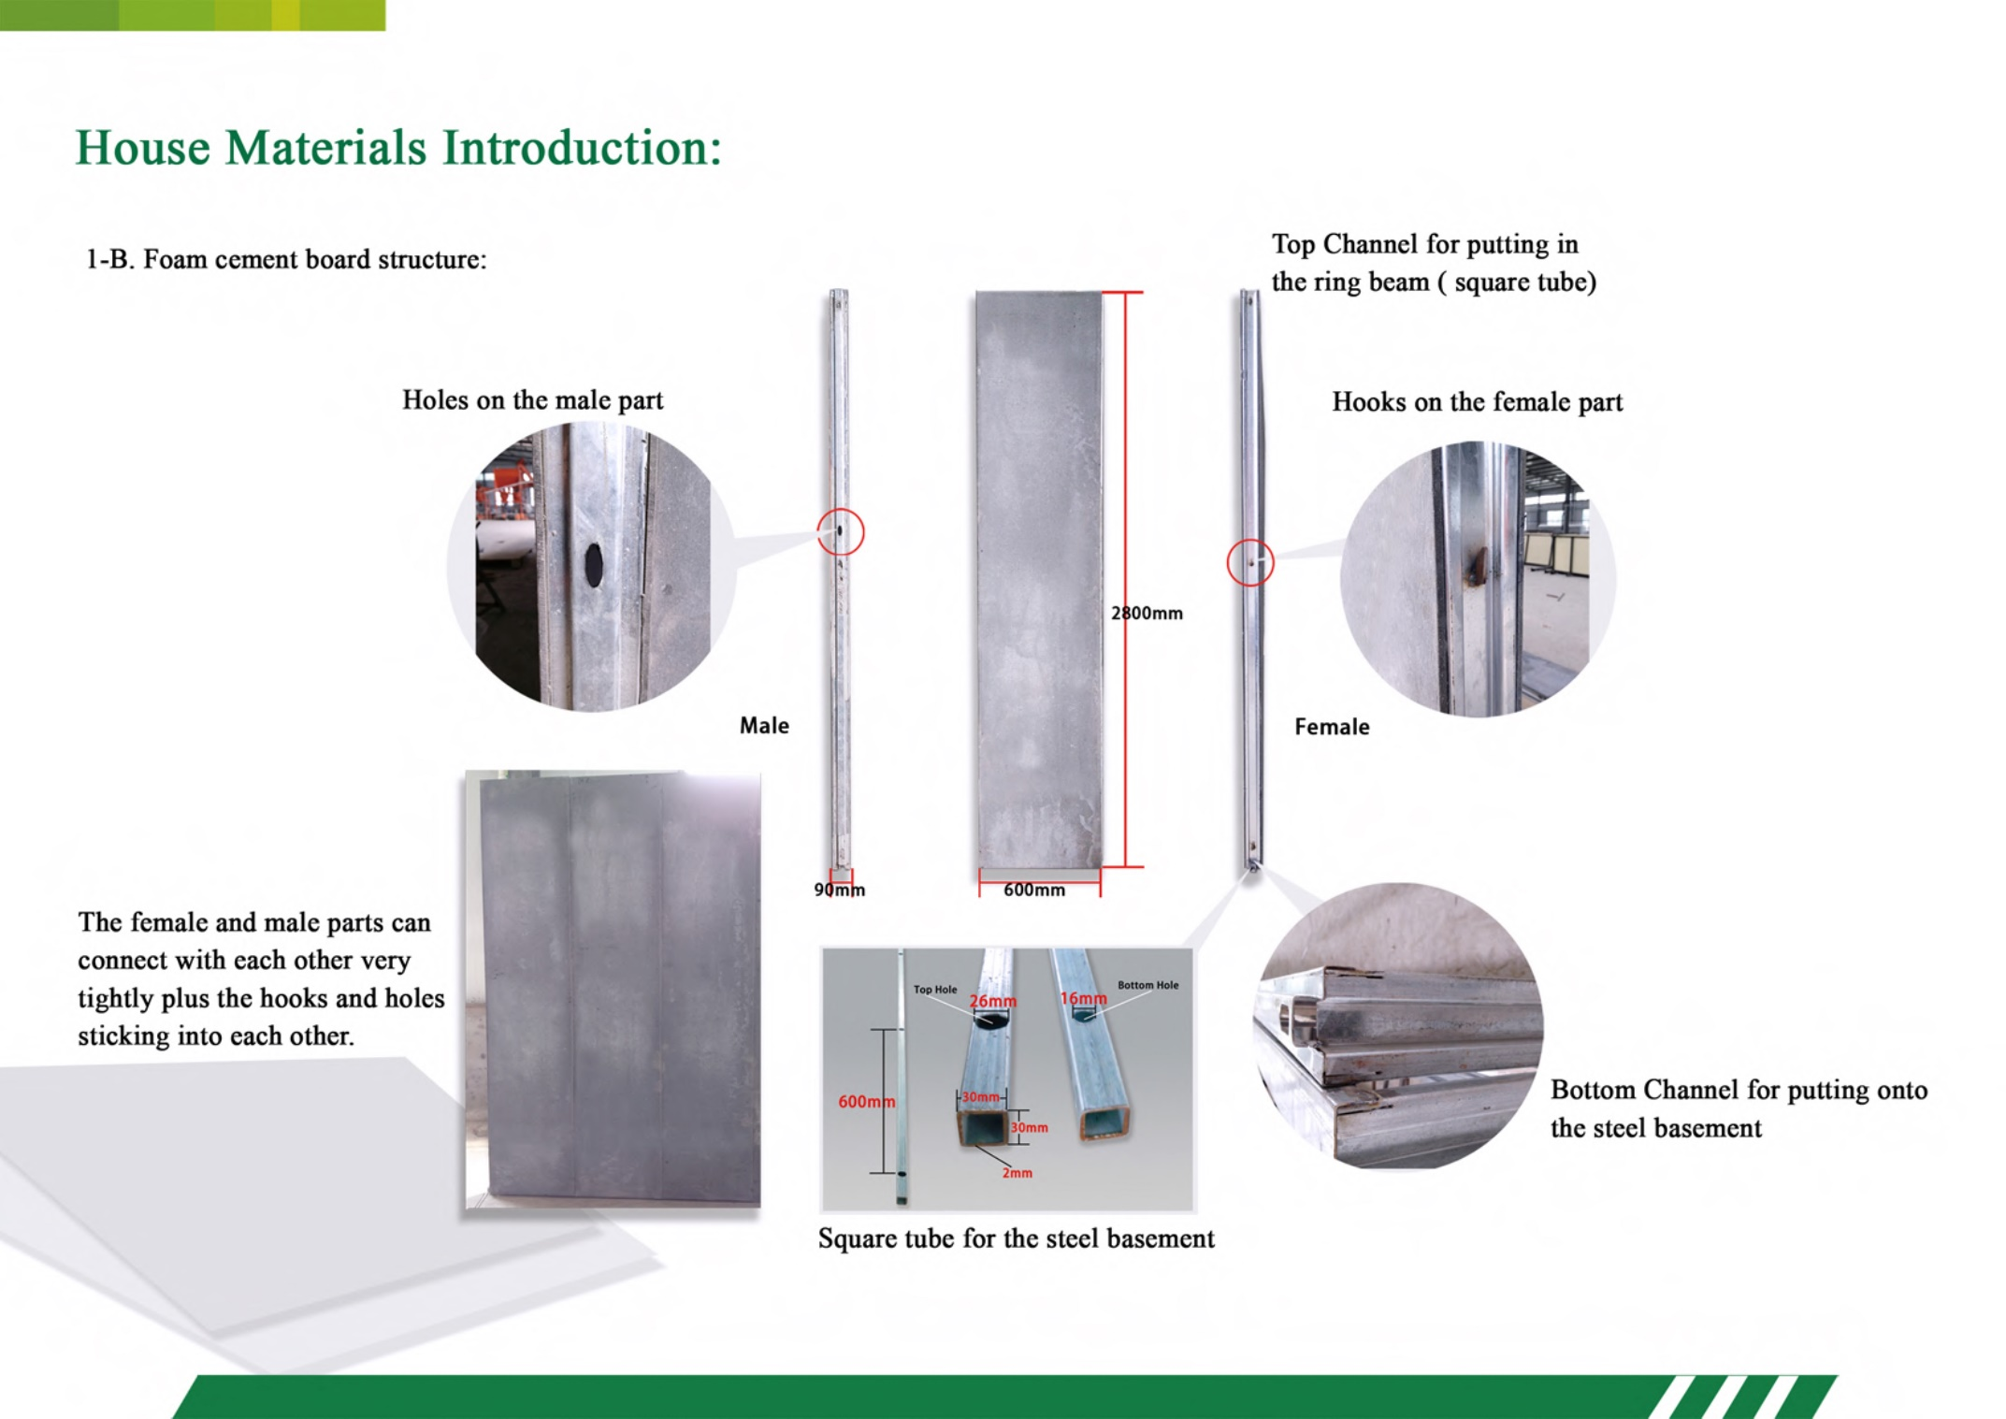

Slide 7
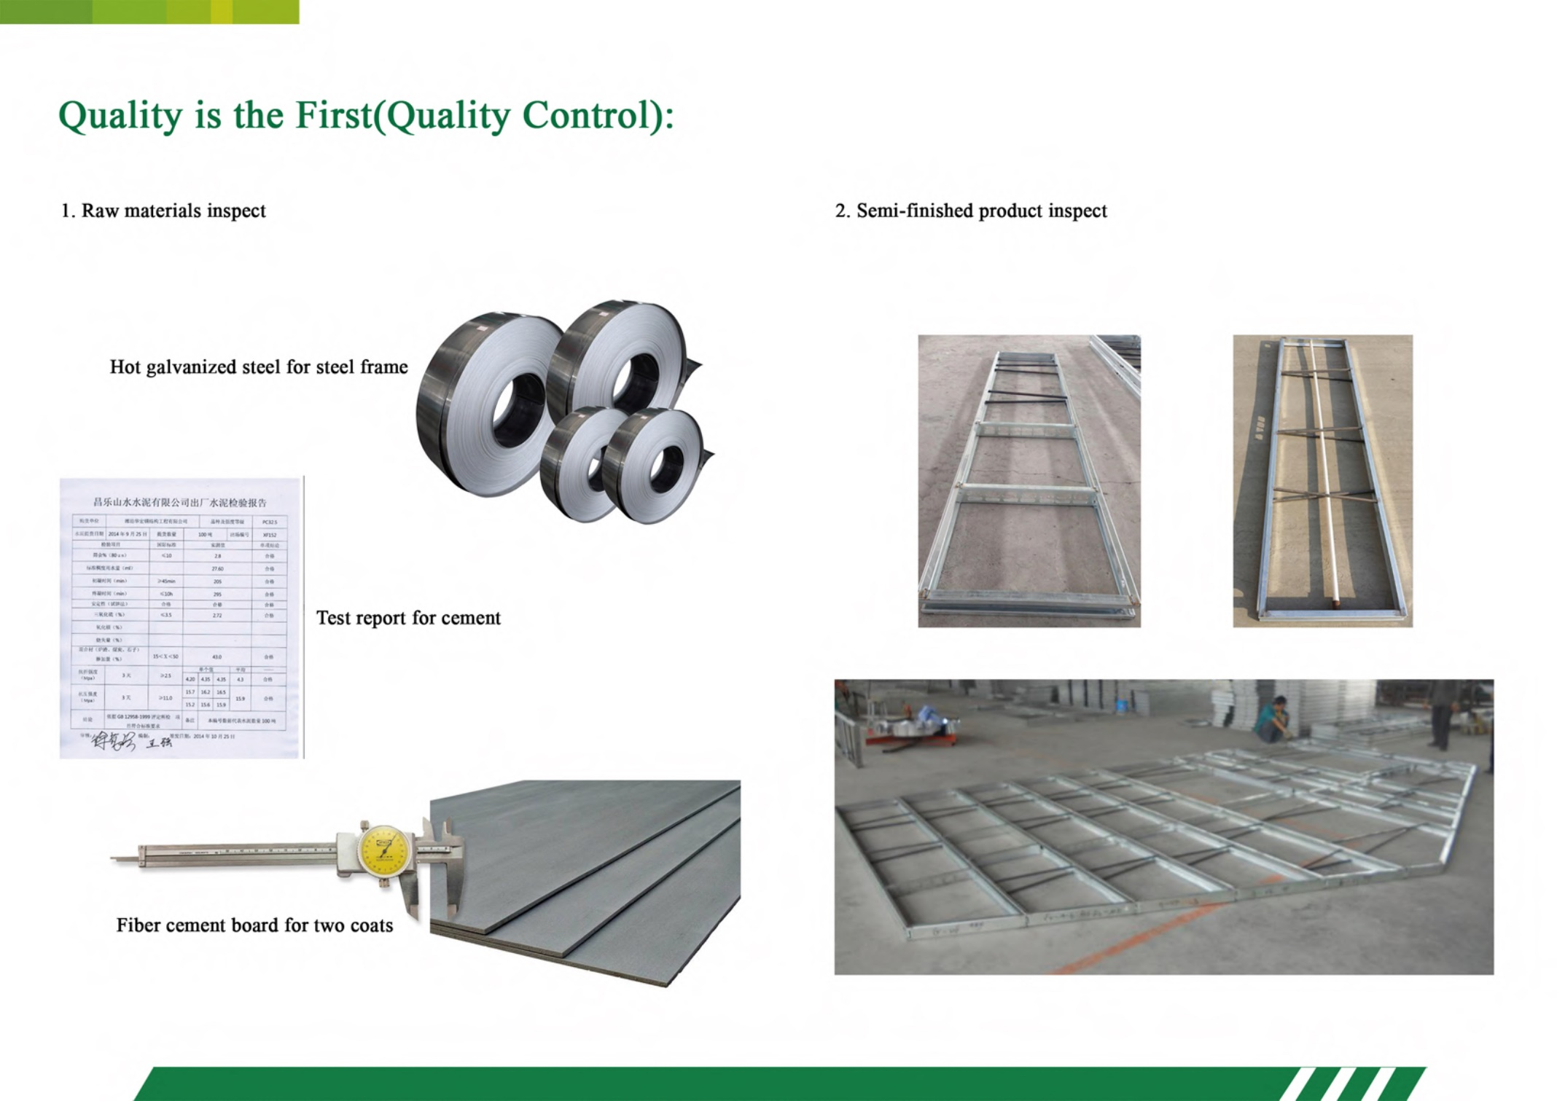

Slide 8
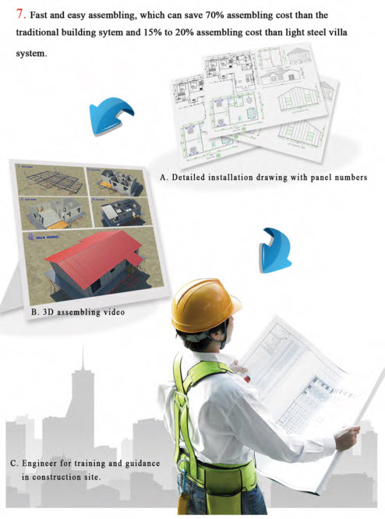
Easy assembly directions
included with each building kit
For illustration, a 200m2
House can be erected
in Three (3) Days
(exterior/interior walls, roof,
doors & windows)
Next, outside and inside wall decorations,
fixtures, plumbing, cabinets, etc.
are installed according to plans

Slide 9
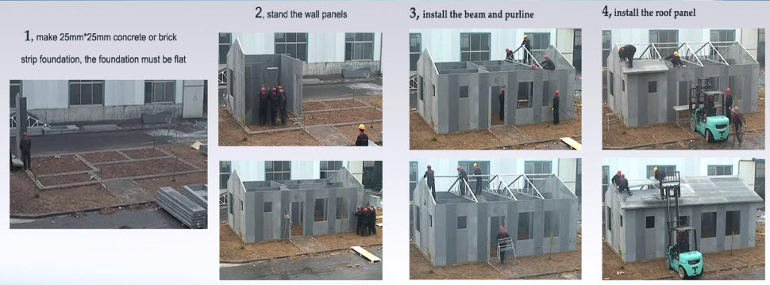
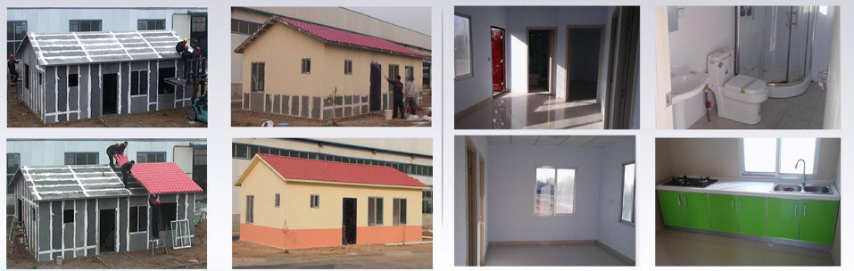
5. Glue, Tape and seal gaps in the walls
6. Apply exterior paint
7. Install flooring, ceiling, wall decoration
8. Install fixtures, cabinets, etc.

Slide 10
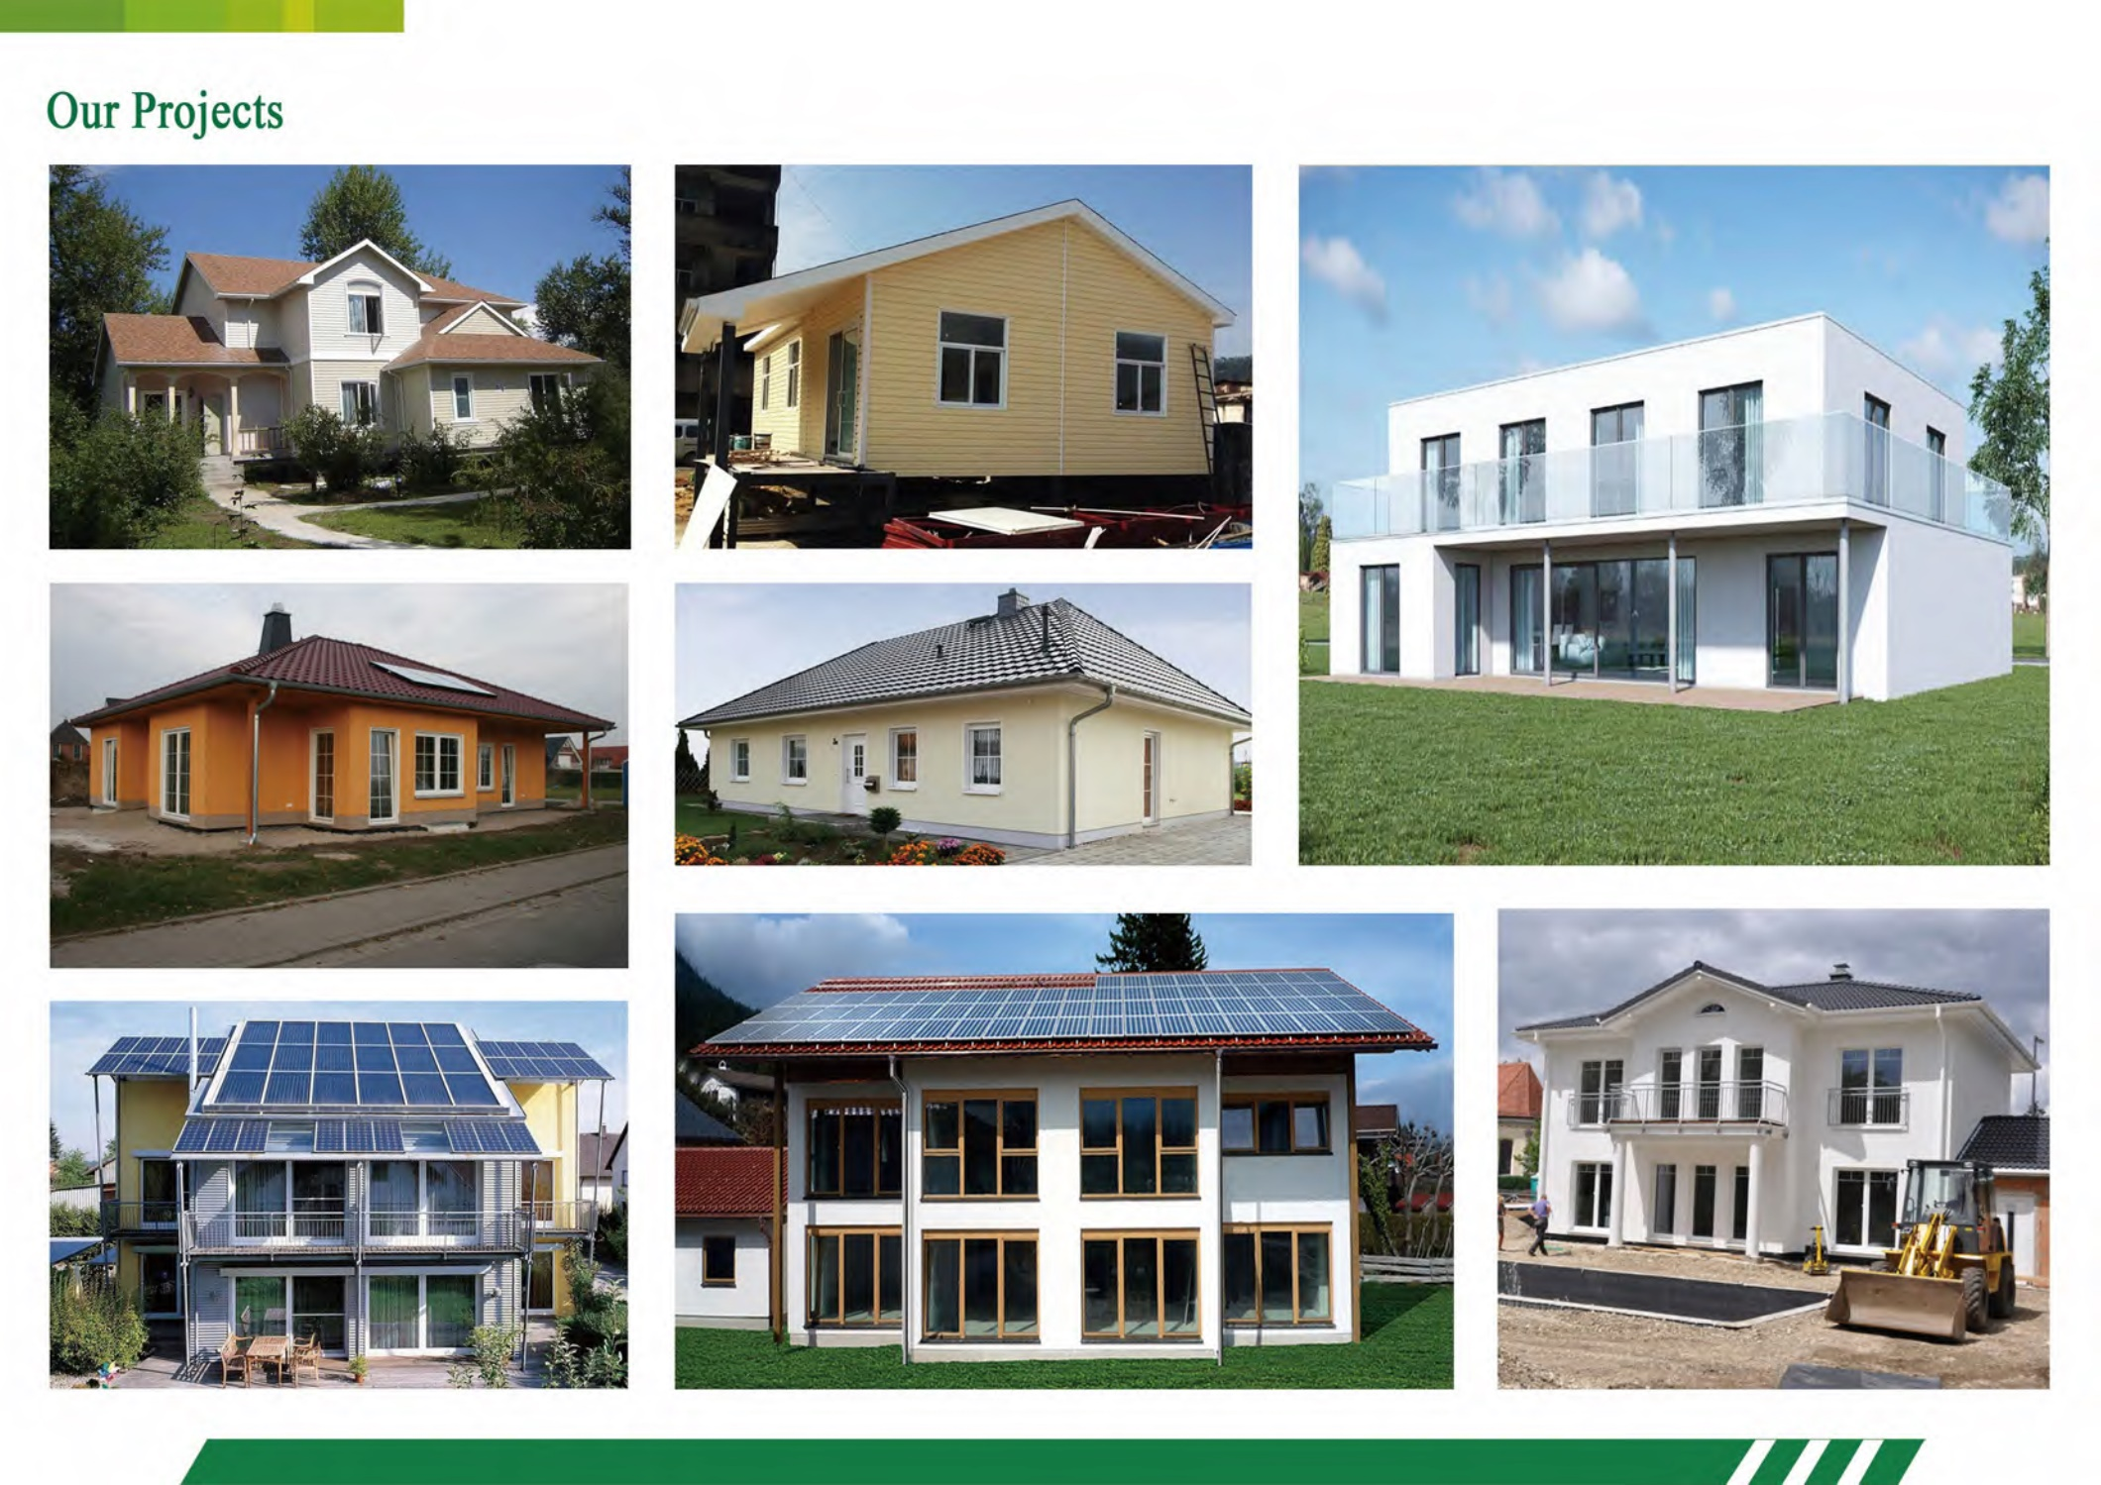

Slide 11
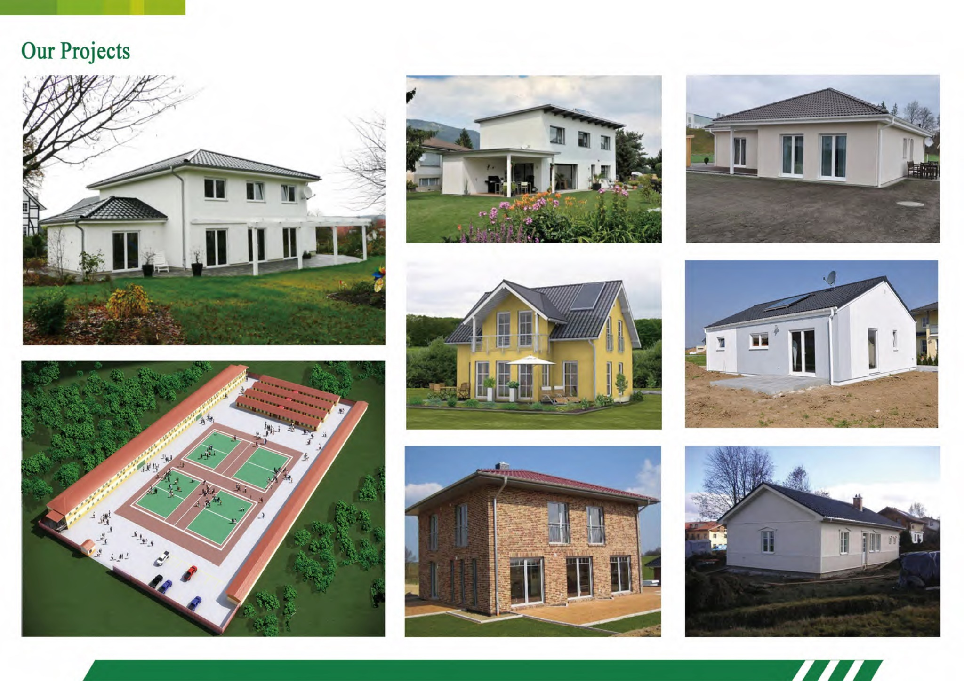

Slide 12
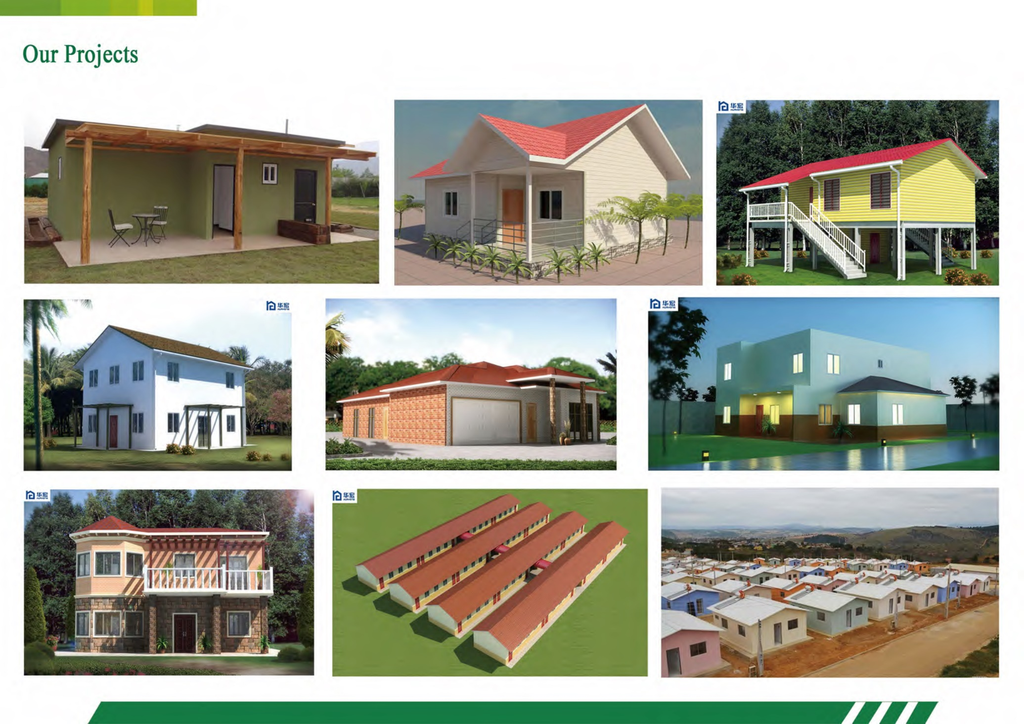

Slide 13
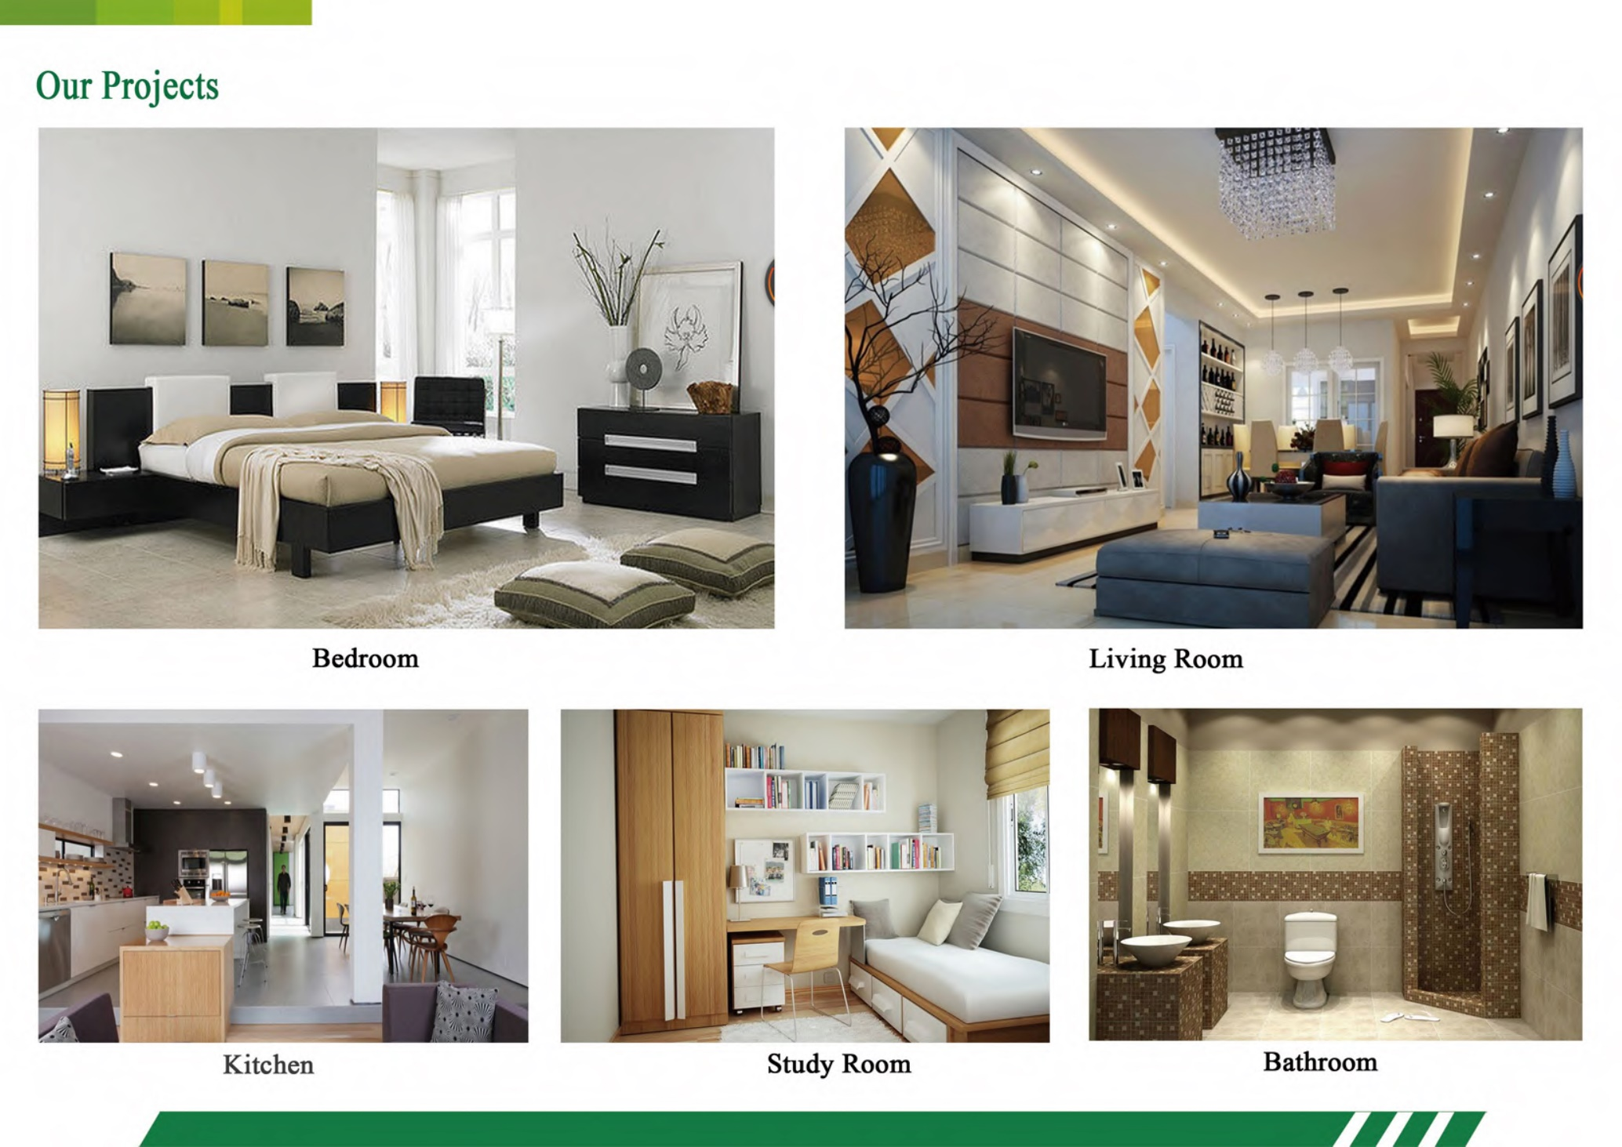

Slide 14

Contact
Allan M. Olbur
224-425-9236
allano@PanLbilt.com
www.PanLbilt.com

